Slide 1
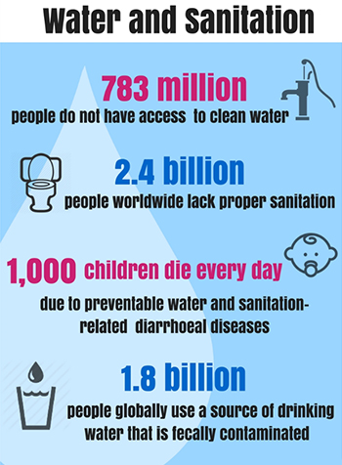

Slide 2
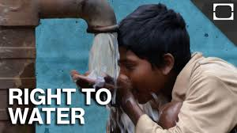
Water: Human right or commodity?
https://www.youtube.com/watch?v=CV68_vW46RY
Do you agree with the United Nations that clean drinking water and access to safe sanitation is a human right? Why or why not?
https://thewaterproject.org/water-scarcity/water_stats

Slide 3
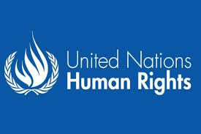
The Human Right to Water
In 2010 the UN declared access to clean water and sanitation a Human Right.
50-100 liters of water per person per day needed to ensure basic needs.
Water source must be within 1,000 meters from home.
Water cost should not exceed 3 percent of house hold income.

Slide 4
www.youtube.com/watch?v=VieZ3hqztlE&feature=c4-overview-vl&list=PLtaayxEPf2h4zsZsX6yBdQsaRi9Gr0bGR.
a. Approximately how many people live without clean drinking water?
b. Where is the water crisis occurring?
c. What is impacted by the water crisis?
d. What are some examples of things that women and children miss out on by spending time gathering water?
e. What makes the walk to get water challenging?
f. What could happen if someone drinks contaminated water?
g. Who is most affected by germs from dirty drinking water?
h. What are solutions to the water crisis?

Slide 5
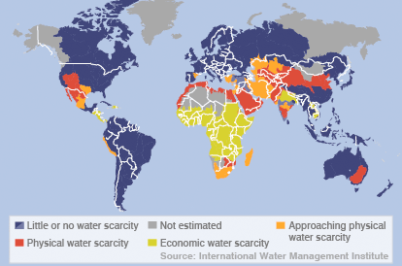

Slide 6
Economic water scarcity is caused by a lack of investment in water infrastructure and exists when a population does not have the necessary monetary means to utilize an adequate source of water.

Slide 7
Physical water scarcity is when there is not enough water to meet all demands, such as those required by an ecosystem to function effectively.

Slide 8
What is the difference between physical and economic water scarcity?
According to the map, where in the world is physical water scarcity present?
According to the map, where in the world is economic water scarcity present?

Slide 9
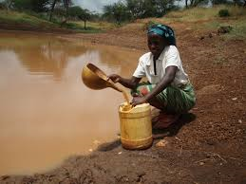
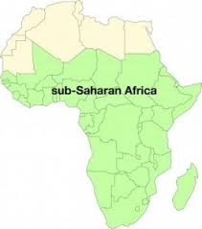
Water Scarcity and Sanitation in Africa
695 million of a global 2.4 billion people living without improved sanitation facilities live in Sub-Saharan Africa

Slide 10
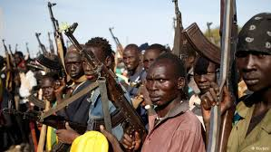
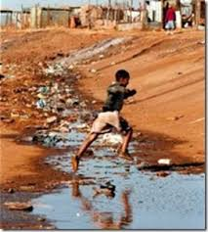
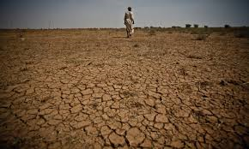
Water Scarcity in Africa - Causes
Overuse of water
Pollution of water
Climate change
Conflict
Distance
Drought

Slide 11
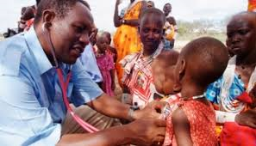
Water Scarcity in Africa - Health
Drinking unsafe water resources contributes to the spread of waterborne diseases, including:
-typhoid fever
-cholera
-dysentery
-diarehea
Question: How can improved health increase education opportunities and lead to economic growth?

Slide 12
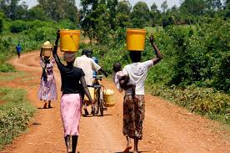
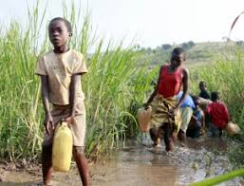
Water Scarcity in Africa – Women & Children
Women and children are often responsible for water collection, which can take 3-4 hours a day.
Question: How does water retrieval done by women and children impact their education and economic opportunities?

Slide 13
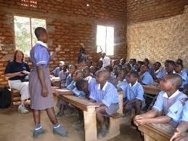
Water Scarcity in Africa – Social and Economic Impact
social and economic consequences of a lack of clean water impact the following:
-education
-employment opportunities
-physical strength and health
-agricultural and industrial development
UN estimates that Sub-Saharan Africa alone loses 40 billion potential work hours per year collecting water.^{[7]}

Slide 14
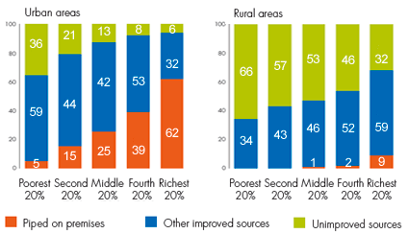
What are two observations you can make about water scarcity in Africa after analyzing both graphs?

Slide 15
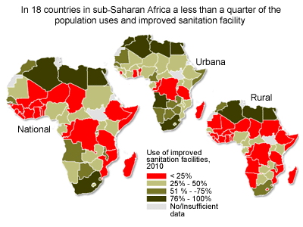

Slide 16
Human Rights Watch
https://www.youtube.com/watch?v=YYPJPHlu_n8
(Zimbabwe)
https://www.youtube.com/watch?v=3jYr8MFTXrM

